Slide 1
SRUK Annual Conference
Oct 2018
Sue Farrington

Slide 2
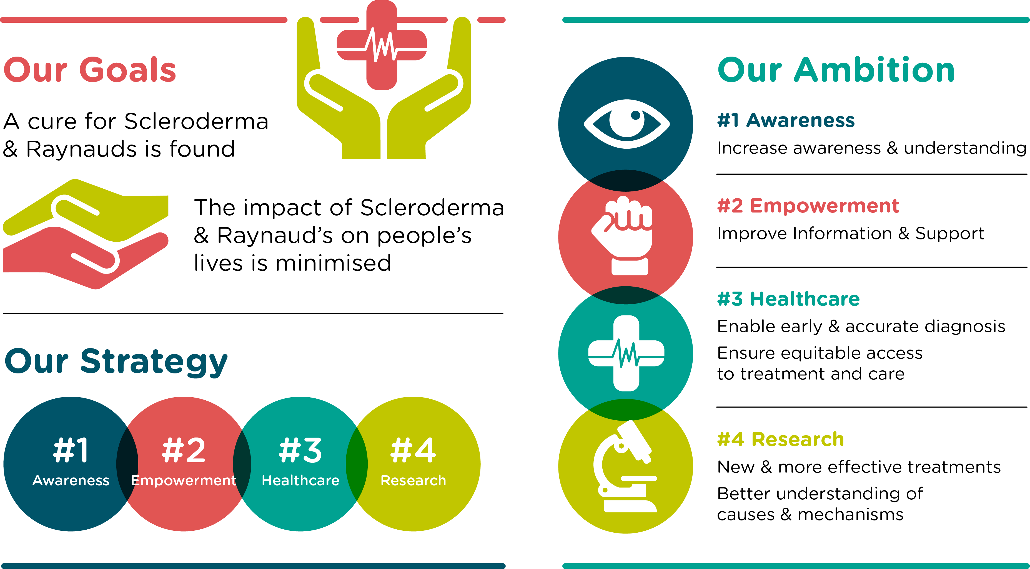

Slide 3
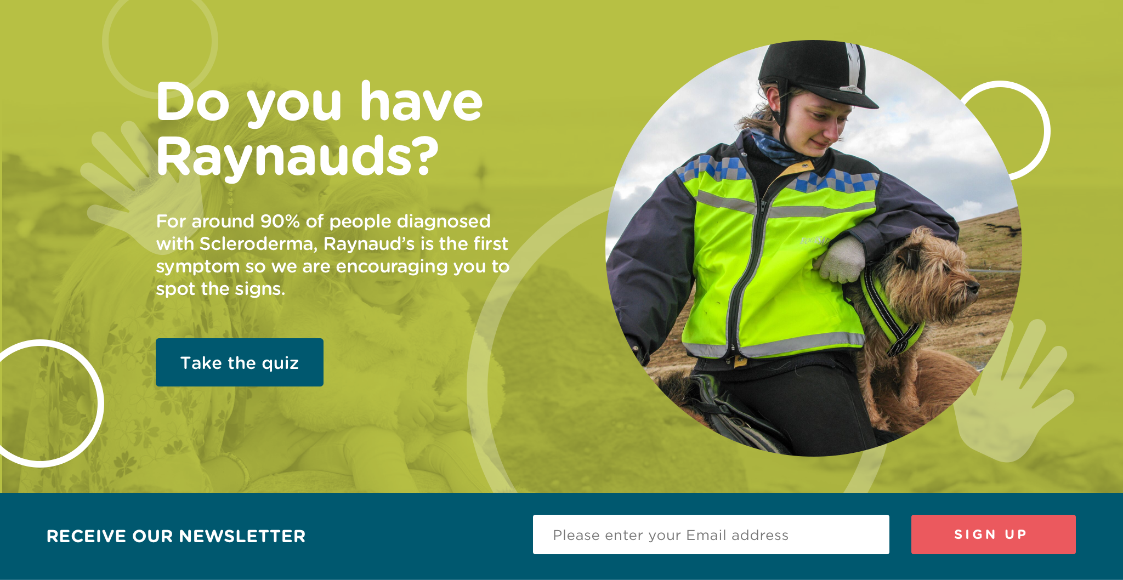
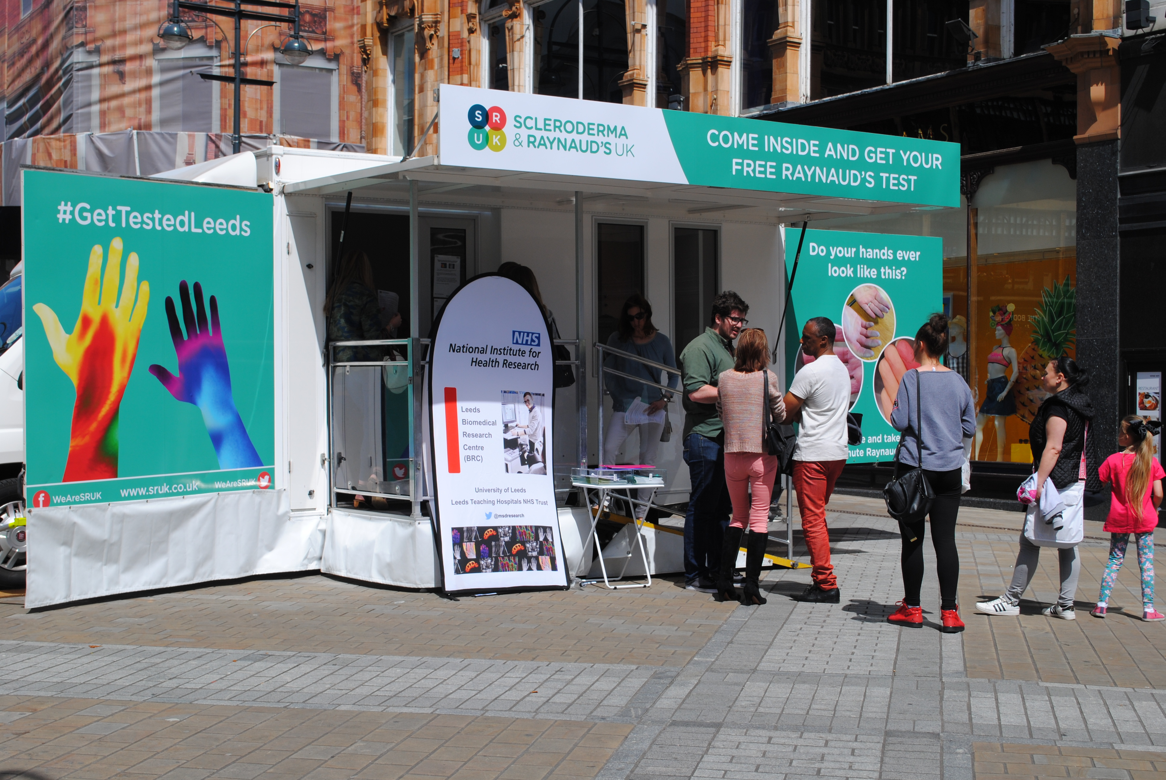
Awareness
Over 6,000 people have take our online Raynaud’s test
Diagnosed over 570 people on the streets of Leeds with our first ever mobile clinic
Notes:
45 Radio Interviews
Over 100,000,000 people reached via press
Reaching countries from all of the world

Slide 4
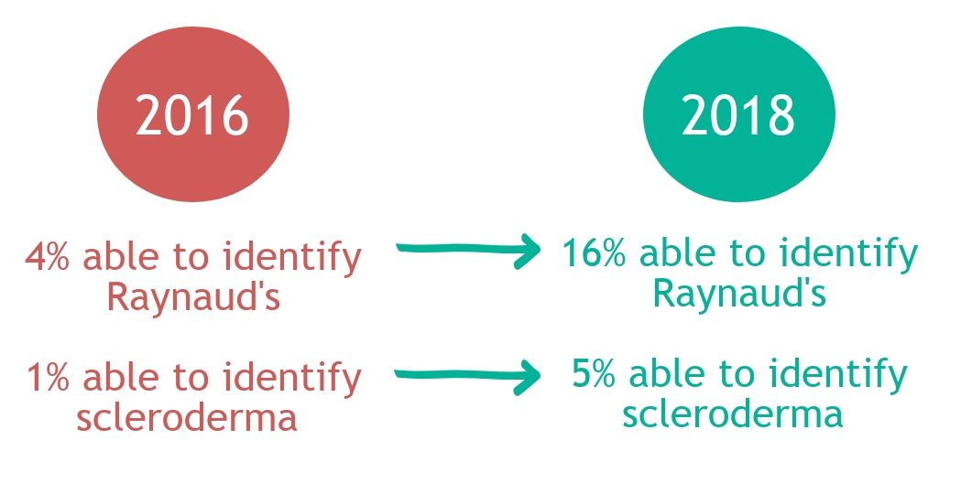
Awareness

Slide 5
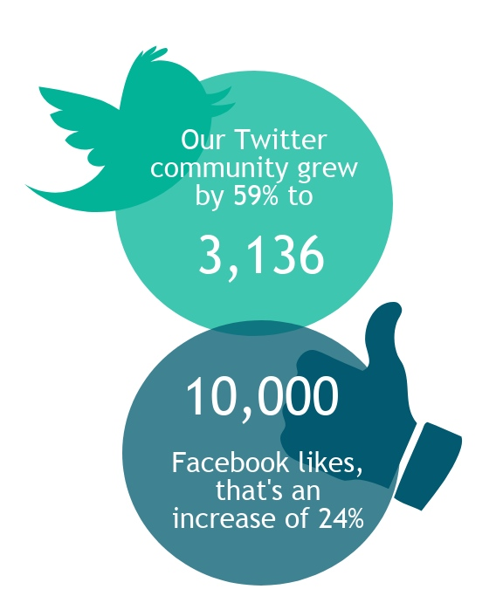
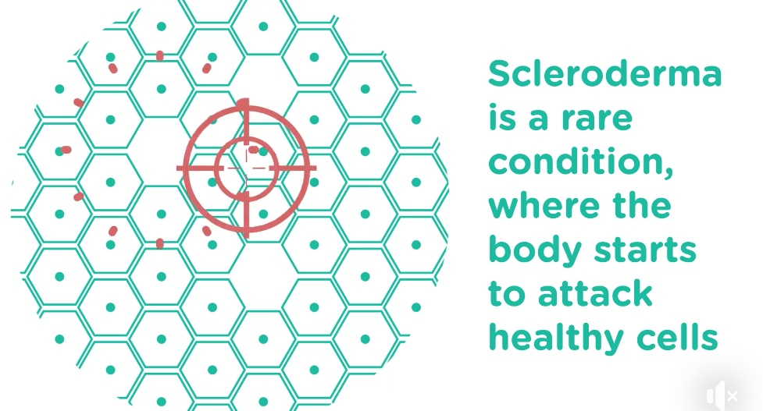
Empowerment
Animation shared over 1,000 times on Facebook and viewed over 36,000 times.

Slide 6
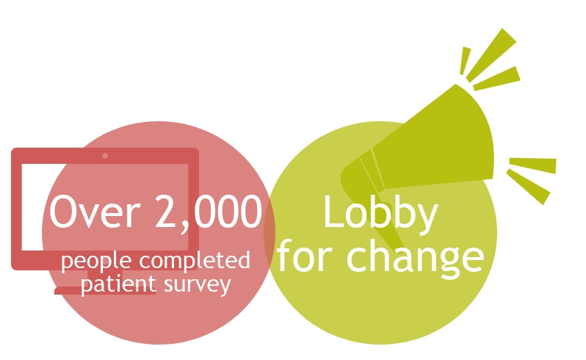
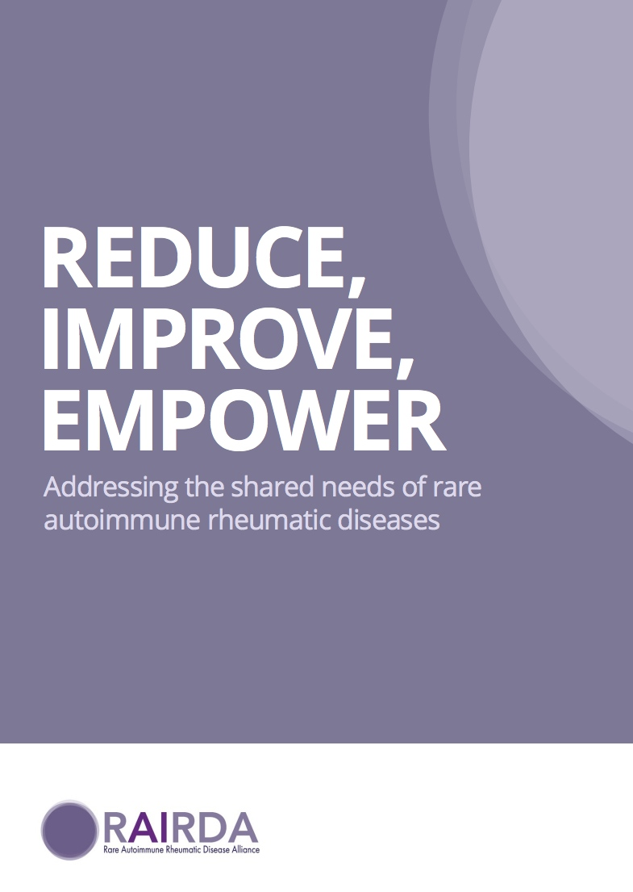
Healthcare

Slide 7
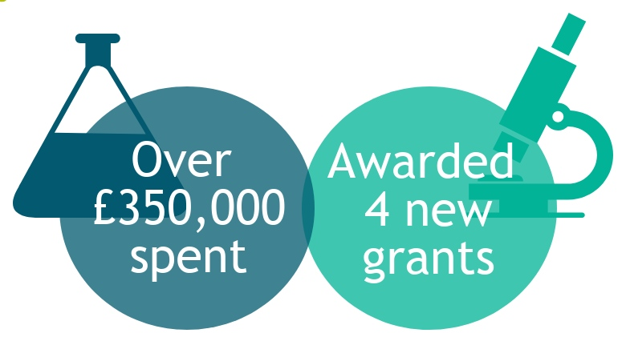
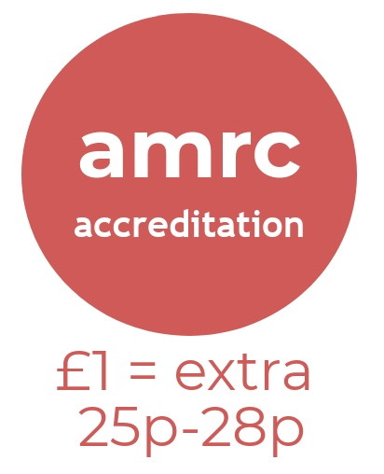

Research

Slide 8
What Next?
Continue awareness campaigns
Strengthen support services
Collaborate to drive change
Develop partnerships to accelerate research

Slide 9
Thank You
sue.farrington@sruk.co.uk
Join the conversation #SRUKAC18

Slide 10
